Slide 1


Company Introduction

Slide 2
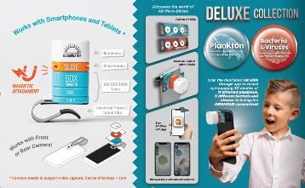
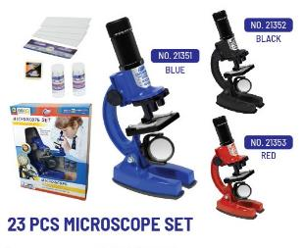
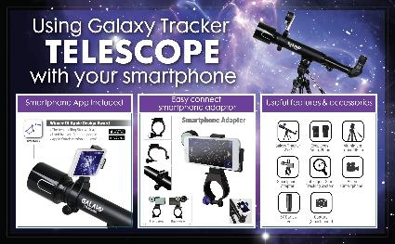
Our background
Award winning AR products
- Eastcolight was established in 1991 in Hong Kong. It has more than 30 years history of producing STEM educational toys.
Fully own a manufacturing factory in ZhongShan, China; has a R & D and Sales and Marketing office setup in Hong Kong.
Eastcolight’s telescope, binoculars and microscope are well recognized throughout the world in the STEM toys industry.
Outside the basic STEM toys, Eastcolight has developed toys with Augmented Reality function, and telescope with STARWALK2 APPS.
The product design team has won various international and local design awards which includes: Good Design Award from Japan, iF Design Award from Germany & A’ design Award from Italy etc.
-

Slide 3
Facts about EASTCOLIGHT (STEM TOYS MANFACTURER)
Carrying
over 500 items
currently
Sell over 110 countries
Has interviewed by CNBC, NHK, Wall Street Journal , New York Times
One of the biggest exhibitor in the H.K. Toys &
Games Fair
Donate to various charities, schools, hospitals and museums etc. in Hong Kong and China

Slide 4

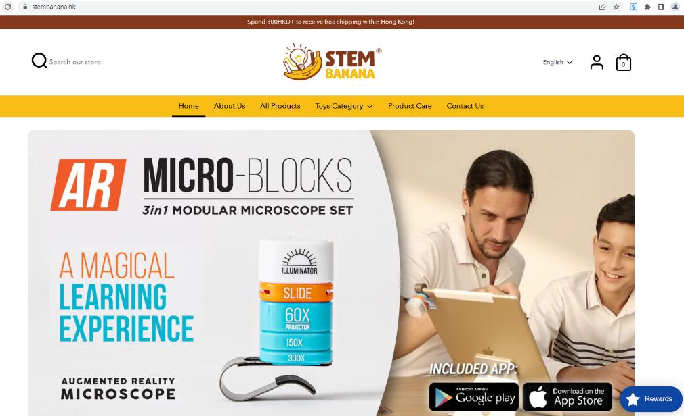
Launch our web store in Hong Kong by 2022

Slide 5
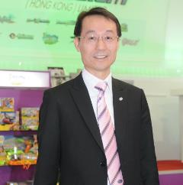
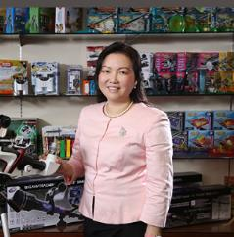
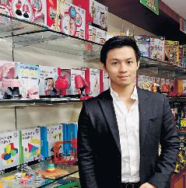
Our Management
Andy Sze
Salley Sze
Johnny Sze
CO-founder & C.E.O.
CO-founder & G.M.
Director &
Vice General Manager
-Director of China Overseas Friendship Association
-Chairman of Hong Kong Basketball Association
-Life Honorary Chairman of Hong Kong Fukien Athletic Club
-Honorary Citizen of Zhongshan, GuangDong, China
-Zhongshan Federation of industry and Commerce
-Chairman of Zhongshan Shenwan Town Federation of Industry & Commerce
-Former Club Presidents of Lions Clubs International District 303
Hong Kong & Macau China(Kwun Tong)
-100 Outstanding Women Entrepreneurs in China (2006 CAWE)
-HKTDC Toys Advisory Council member (2006-2008, 2015-2017)
-Honorary President of H.K. Basketball Association (Since 2005)
-Founder and Creative Director of Royal Dragon Group (H.K.) Ltd
-2021 Forbes China 30 Under 30
-Executive Comm. Mem. of FHKI Group 19 (H.K Toys Council)
-Former Comm. of HKTDC Toy Advisory Council
-Deputy Sec. General of H.K. United Youth Association
-Graduated from University of California San Diego, Econ. and Business

Slide 6
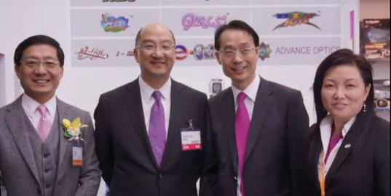
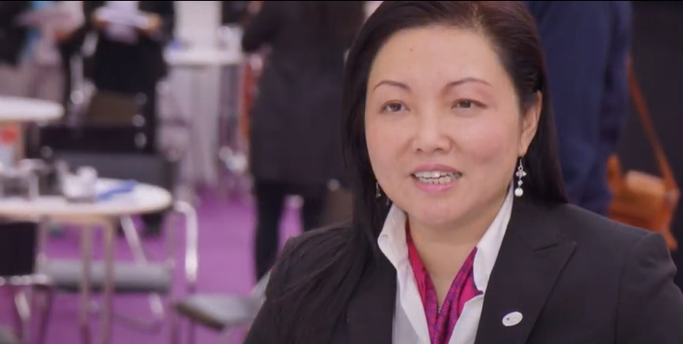
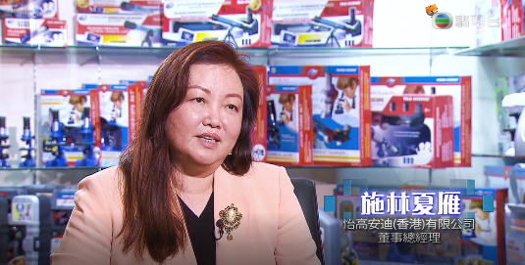
TVB Jade Program Interview

Slide 7
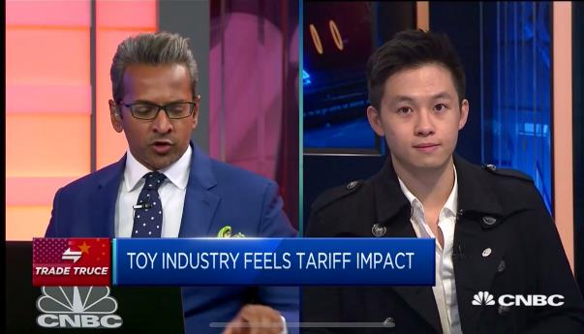
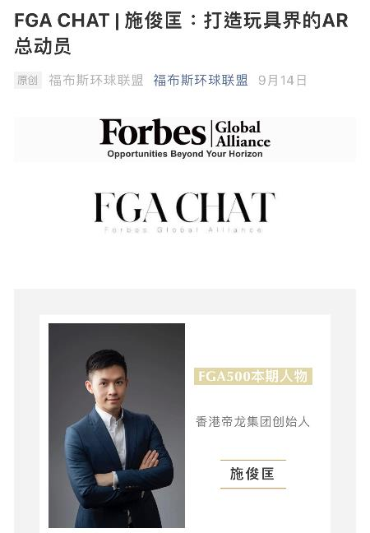
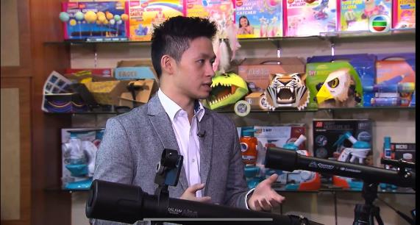
CNBC, Pearl & Forbes Interview

Slide 8
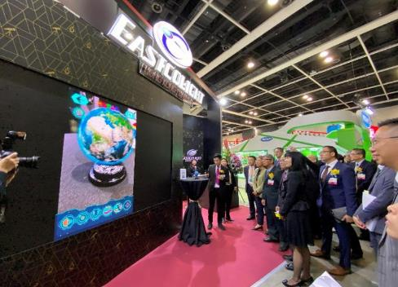
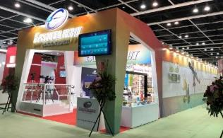

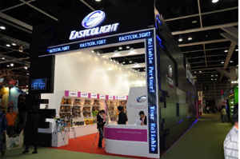
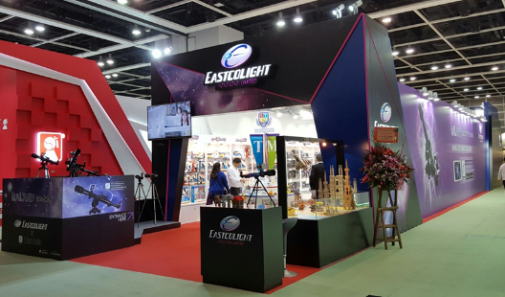
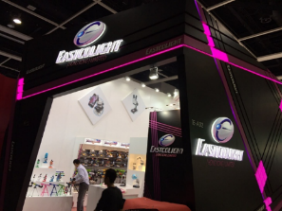
January 2020
Eastcolight’s
Marketing
Hong Kong
Toys & Games Fairs
January 2018

Slide 9
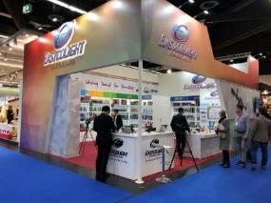
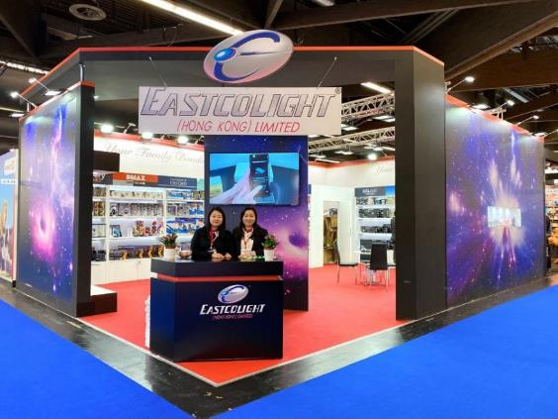
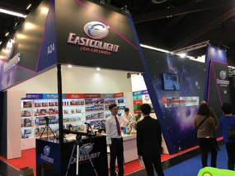
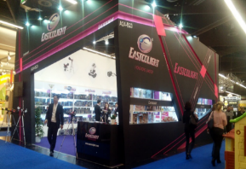
January 2020
Eastcolight’s
Marketing
Spiel Warenmesse
International Toy Fair
Nuremberg, Germany

Slide 10
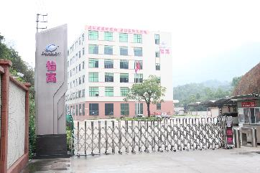
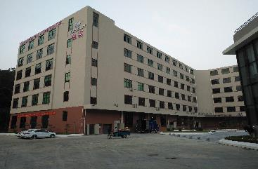
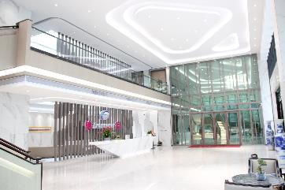
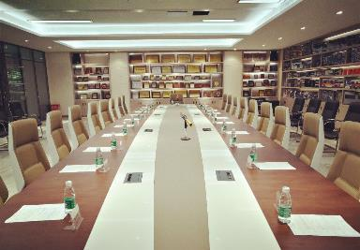
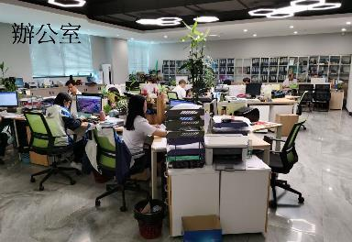
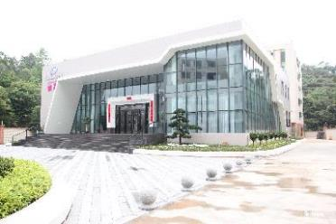
Our Production Plant in Zhong Shan China
Main Entrance
Main Building
Reception
Office building
Conference room
Office

Slide 11
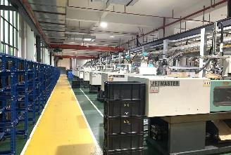
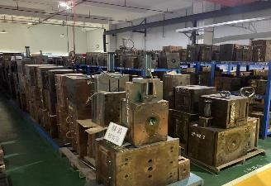
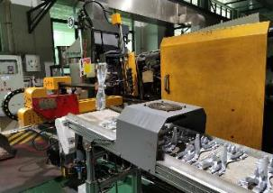
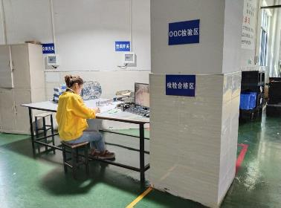
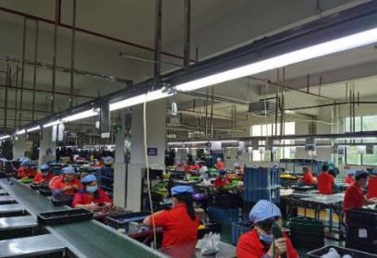
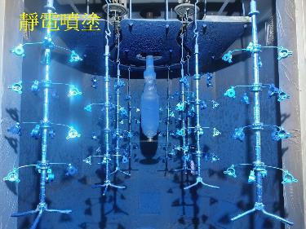
Our Production Plant in Zhong Shan China
Plastic Injection machine
Tooling department
Die cast machine
Auto color spray machine
(Imported from Germany)
Production line (Assembly)
Quality Control area
www.AAAPETS.com

Slide 12


































Renowned customers + Licenses

